Slide 1


PROJECT IMPLEMENTATION REPORT
My Real-Time Stock Market Data Engineering Pipeline
Author: Ayush Kumar Sahu
Date: December 6, 2025
A technical deep-dive into the architecture and code I developed.

Slide 2



My Project Objective
Why I Built This
What I Achieved
I recognized that traditional batch processing (ETL) is too slow for modern financial analysis. Traders need to see price changes as they happen, not the next day.
I successfully engineered a full pipeline integrating 5 major technologies.
Result: A live dashboard for AAPL, AMZN, and TSLA that updates every minute, enabling immediate trend analysis for volatility and sector rotation.
My Goal: To build a system that captures stock prices from the Finnhub API and visualizes them within seconds.

Slide 3
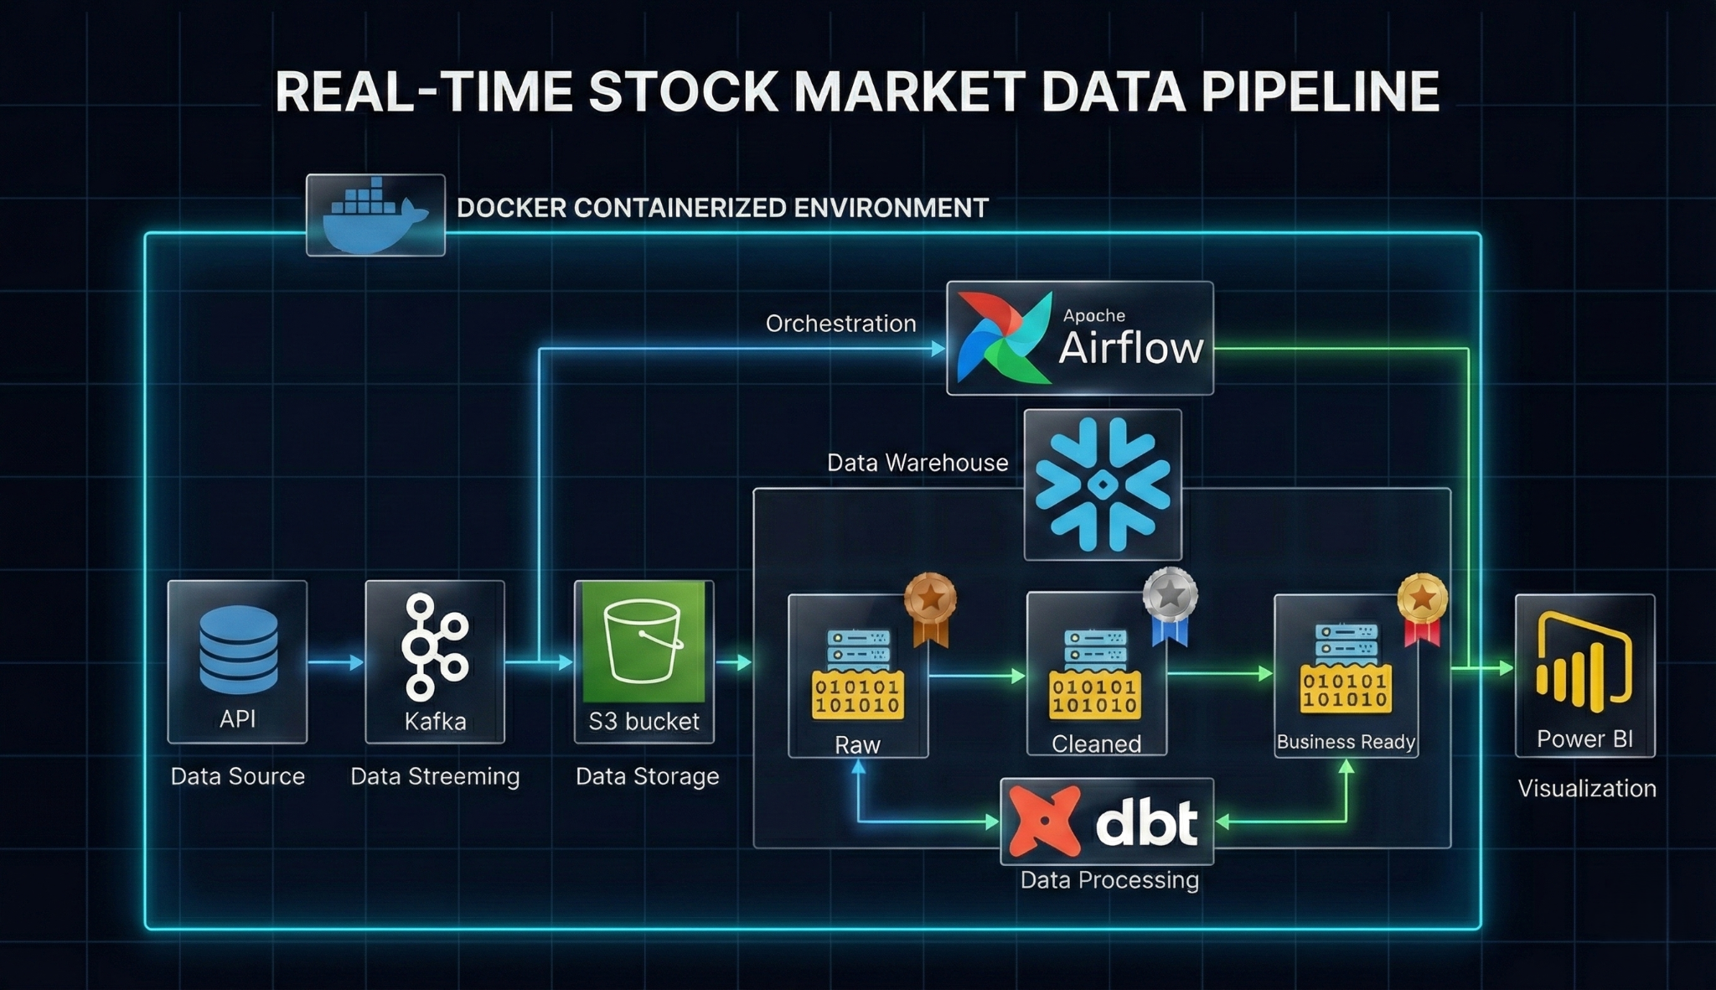
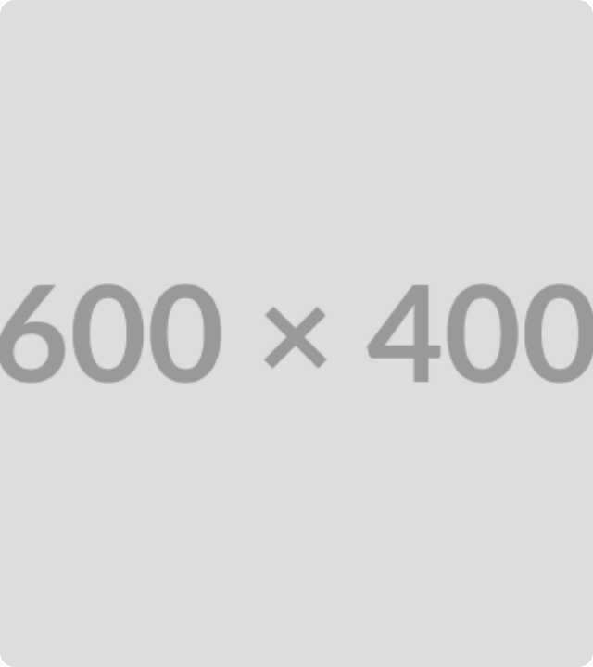
The Architecture I Designed
I designed a Microservices Architecture to ensure each part of my system could scale independently.
1. Ingestion: I used Kafka to buffer rapid API data.
2. Orchestration: I set up Airflow to trigger loads.
3. Storage: I implemented a Lakehouse with MinIO & Snowflake.
4. Visualization: I connected Power BI via DirectQuery.

Slide 4

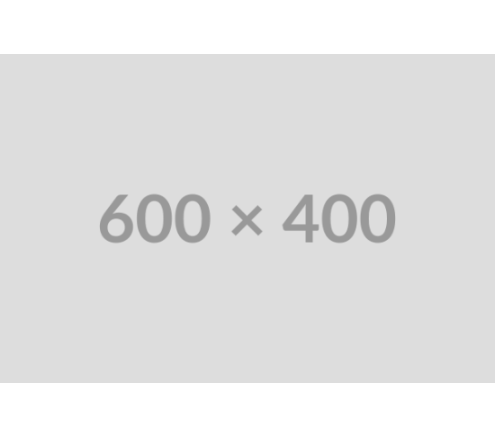
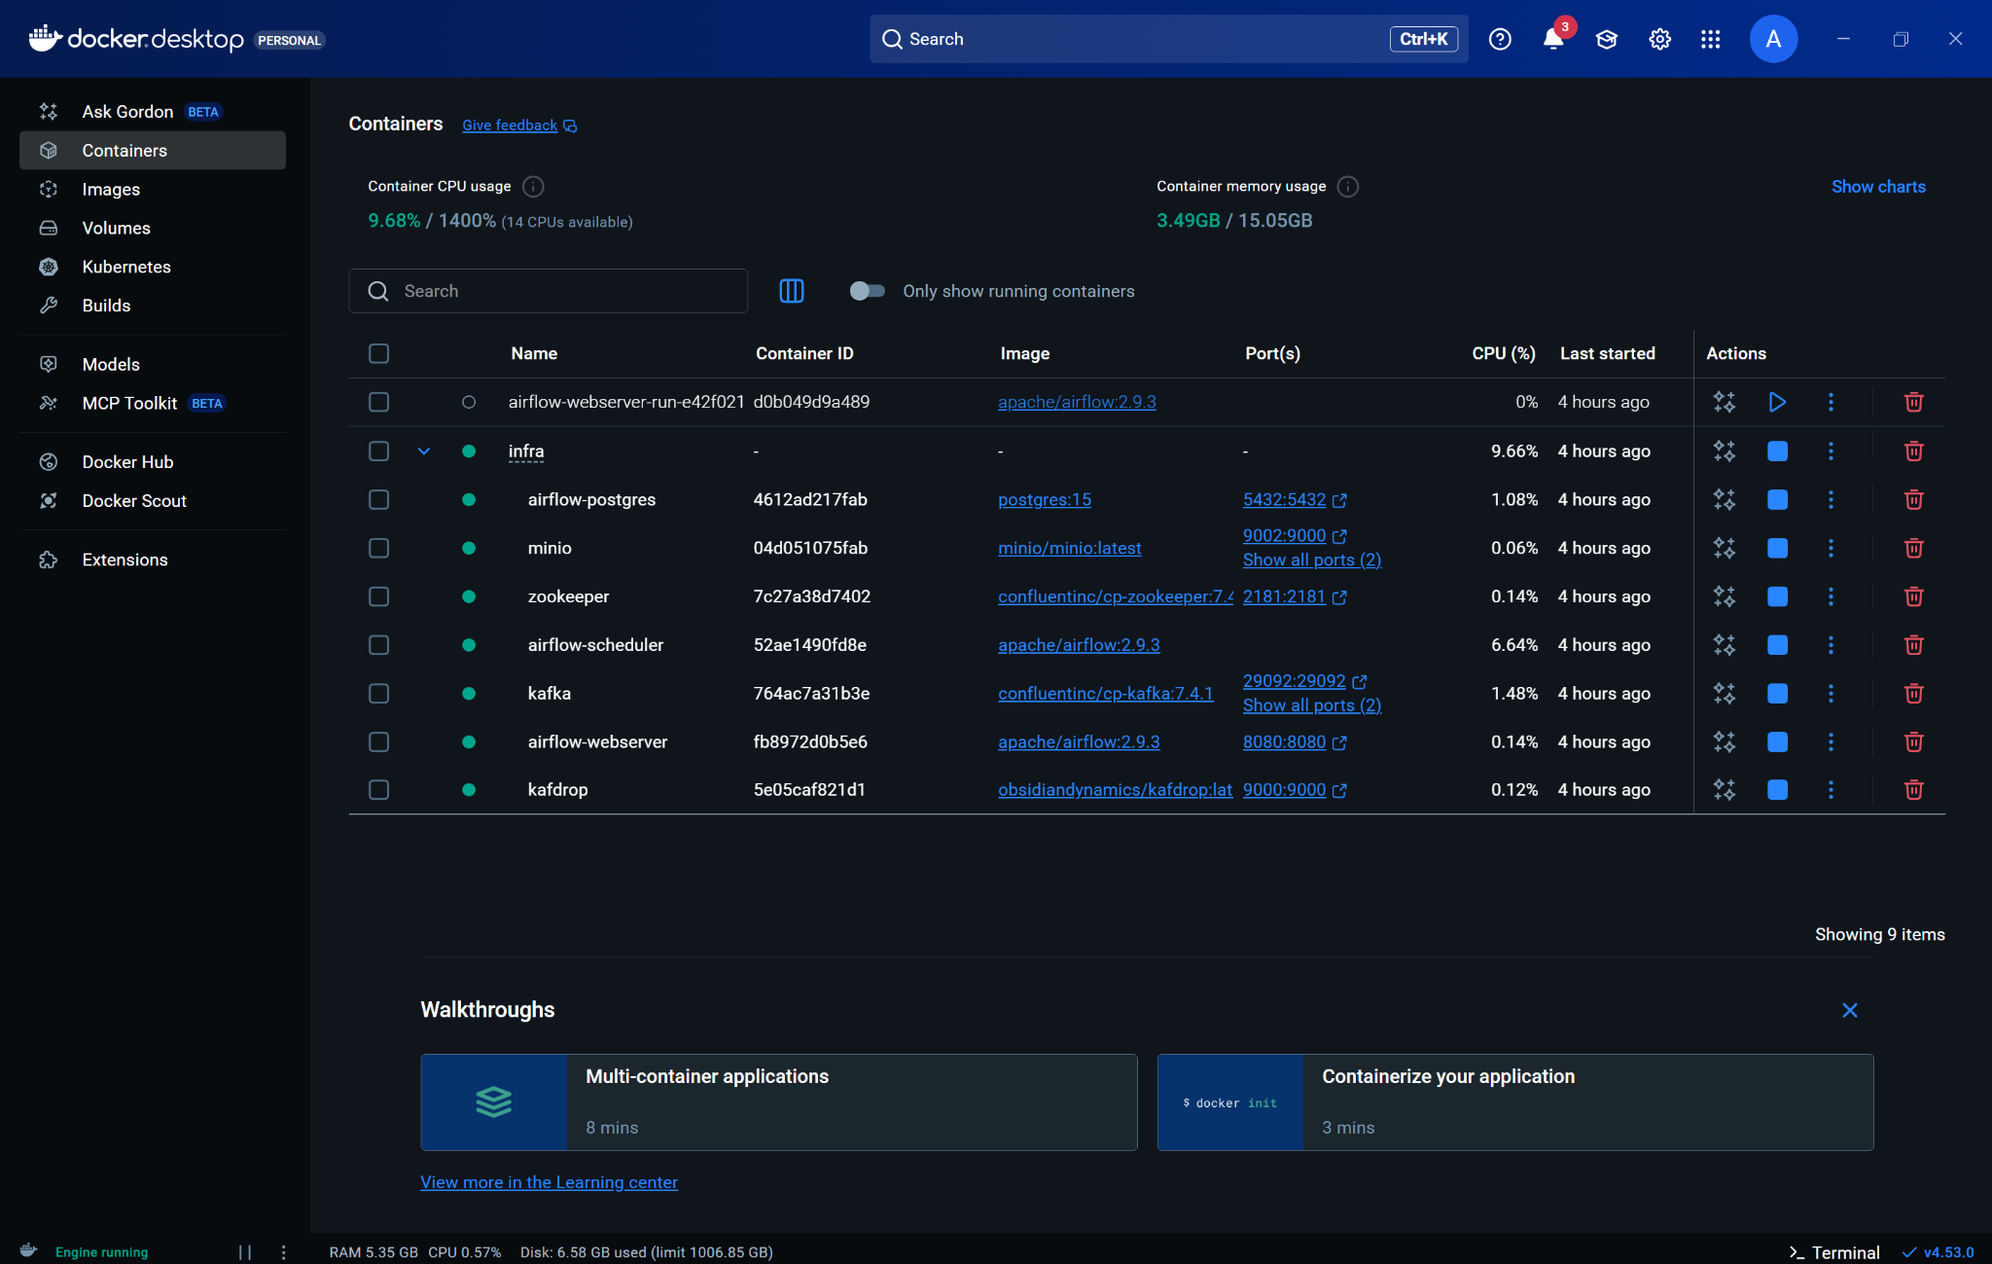
Step 1: My Infrastructure Setup
Solving Reproducibility
To avoid "it works on my machine" issues, I containerized every service using Docker.
Service Isolation: I gave each tool (Kafka, Zookeeper, Airflow) its own container to prevent dependency conflicts.
Networking: I configured a private bridge network so my services could talk to each other securely.
Deployment: I wrote a single docker-compose.yml file to spin up the entire stack with one command.

Slide 5
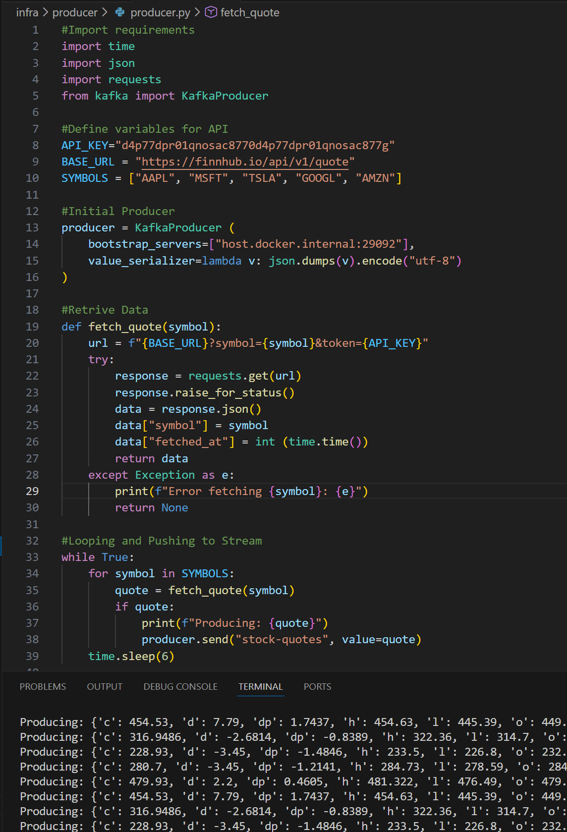
Step 2: How I Handled Real-Time Data
The Producer Service
I wrote a Python script acting as a "Producer" to interface with the stock market.
API Integration: My script polls the Finnhub API for real-time quotes.
Buffering: Instead of writing directly to a database (which might crash under load), I push data to a Kafka topic named stock-quotes.
Reliability: This ensures that if my database goes down for maintenance, no stock data is lost—it just waits in Kafka.

Slide 6
Step 3: How I Automate the Flow
My Micro-Batch Strategy
The Logic I Wrote
Streaming data is hard to query, so I implemented a "Micro-Batch" approach using Apache Airflow.
Task 1 (Extract): I grab the last minute of data from Kafka and save it as a JSON file in MinIO (my Object Store).
I configured my DAG (Directed Acyclic Graph) to run every single minute (*/1 * * * *). This creates a near real-time experience while keeping the data manageable.
Task 2 (Load): I trigger a Snowflake command to load that specific JSON file into my staging tables.

Slide 7
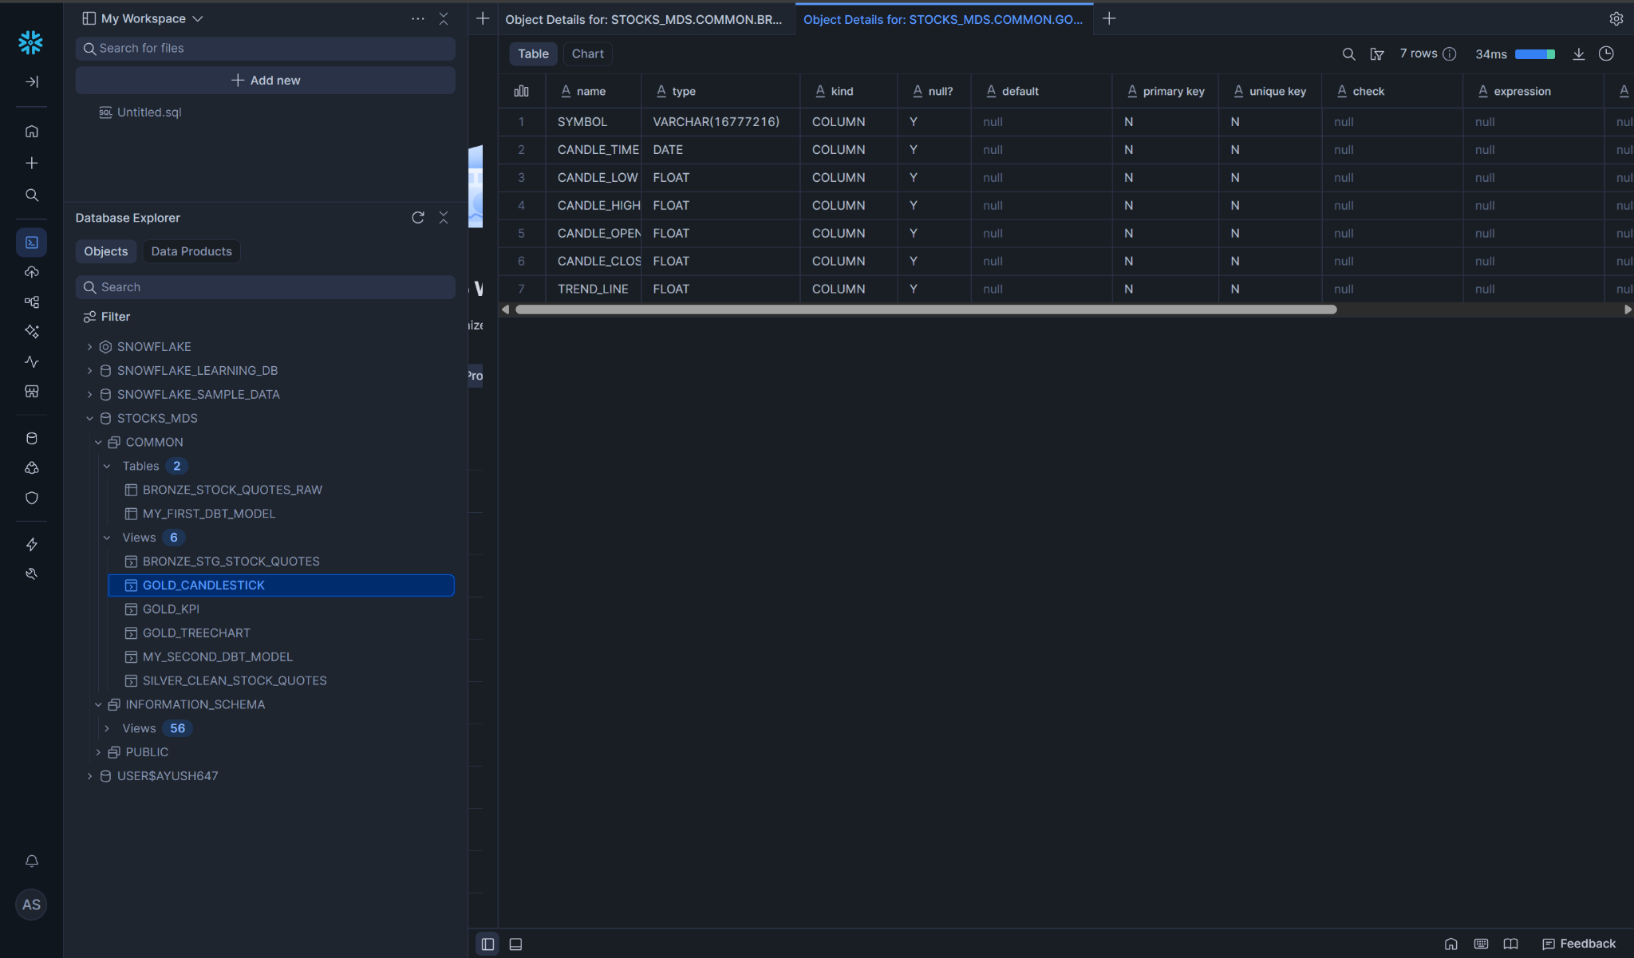
Step 4: My Warehousing Strategy
Handling Messy Data
I chose Snowflake because I didn't want to spend weeks defining strict database schemas.
Schema-on-Read: I used Snowflake's VARIANT data type. This allowed me to dump the raw JSON straight into the table.
Security: I set up specific roles to ensure only my Airflow service could write data, while my BI tools could only read it.
Efficiency: I utilized the COPY INTO command for bulk loading, which is much faster than inserting row by row.

Slide 8








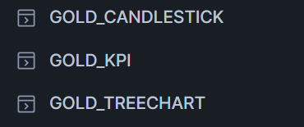
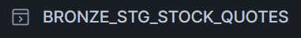

Step 5: How I Cleaned the Data
The Bronze Layer
The Silver Layer
The Gold Layer
Raw Ingestion I kept a table of raw JSON. This is my safety net—if I make a mistake in my code, I can always go back to this original data.
Parsing & Formatting I wrote SQL models in dbt to extract fields like price, symbol, and timestamp from the JSON blob into real columns.
Business Logic I calculated the metrics that matter, like "Volatility" and "Percent Change," so the dashboard doesn't have to do the math.

Slide 9
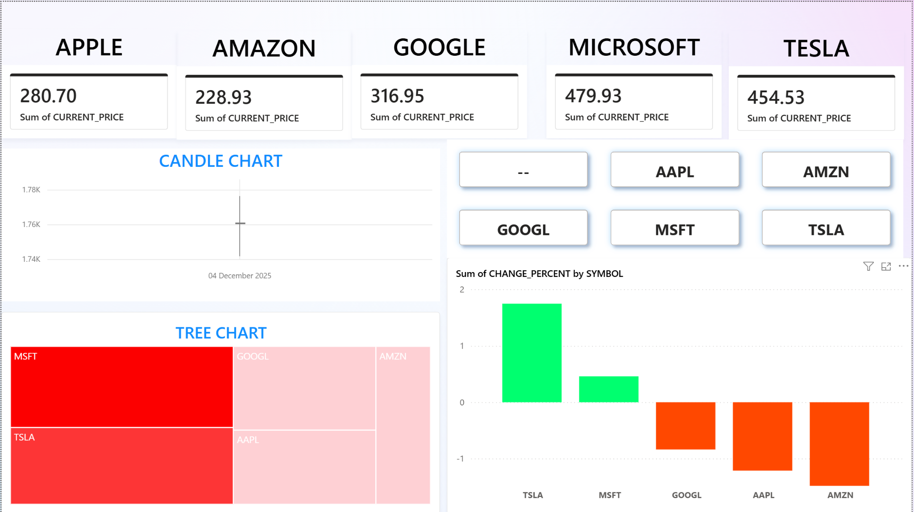
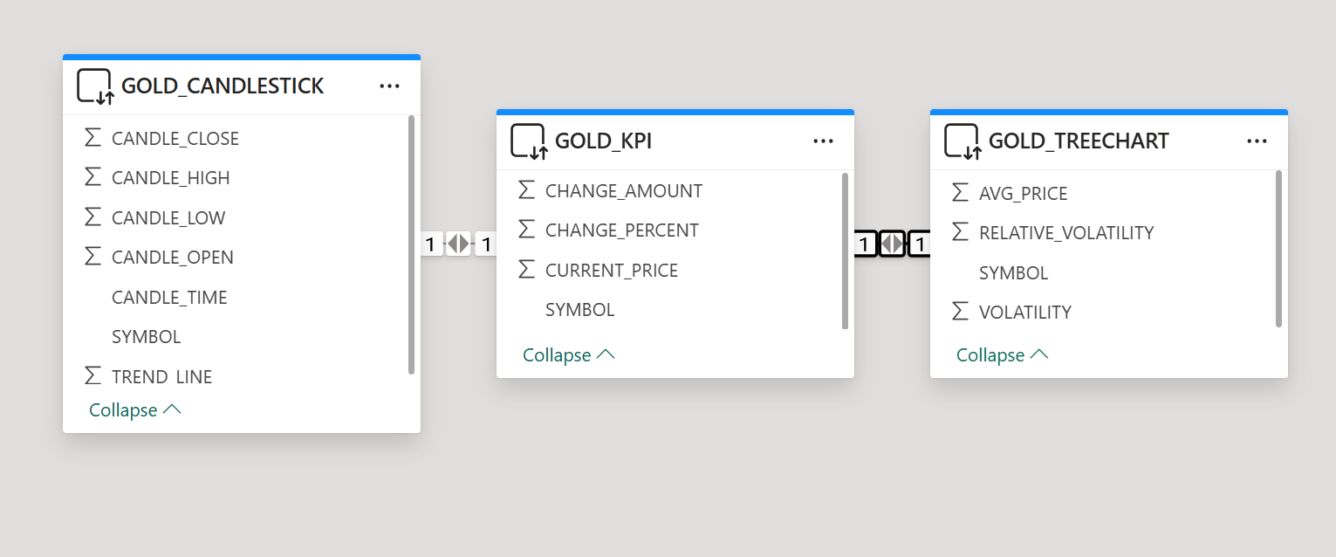
Step 6: The Final Product
I built this dashboard in Power BI to visualize the results of my pipeline.
Key Features I Added:
Live Connection: I used DirectQuery mode so the charts update as soon as Snowflake gets new data.
Metric Cards: Top-level stats for instant decision making.
Deep Dive: Detailed candlestick charts for technical analysis.

Slide 10
Conclusion & My Key Learnings
What I Learned
What I'll Do Next
Latency Matters: Moving from batch to streaming required a completely different mindset regarding error handling and data buffering.
Scaling: I plan to migrate my Docker containers to Kubernetes to handle more stock symbols.
AI Integration: My next step is to feed this clean Gold data into an LSTM model to predict future prices.
Decoupling is Critical: Using Kafka saved my pipeline from breaking several times when the API rate-limited my requests.

Slide 11
THANK YOU
Thank you for viewing my work.

